Slide 1
FEATURE TRANSFORMATION
Himanshu Shukla
(Data Scientist)

Slide 2
What we learn today
Encoding
Label Encoding
One hot Encoding
Dummy variable

Slide 3

HELLO!
I am Himanshu Shukla
I am here because I love Data Science.
You can find me at himanshu.shukla.him@gmail.com

Slide 4
1. Feature Transformation
Let’s start with the first set of slides

Slide 5
Feature transformation is a mathematical transformation in which we apply a mathematical formula to a particular column(feature) and transform the values which are useful for our further analysis.

Slide 6
Feature Transformation
Feature Transformation
Missing value Imputation
Outlier Detection
Feature Scaling
Handling Categorical Features
Mathematical Transformation

Slide 7
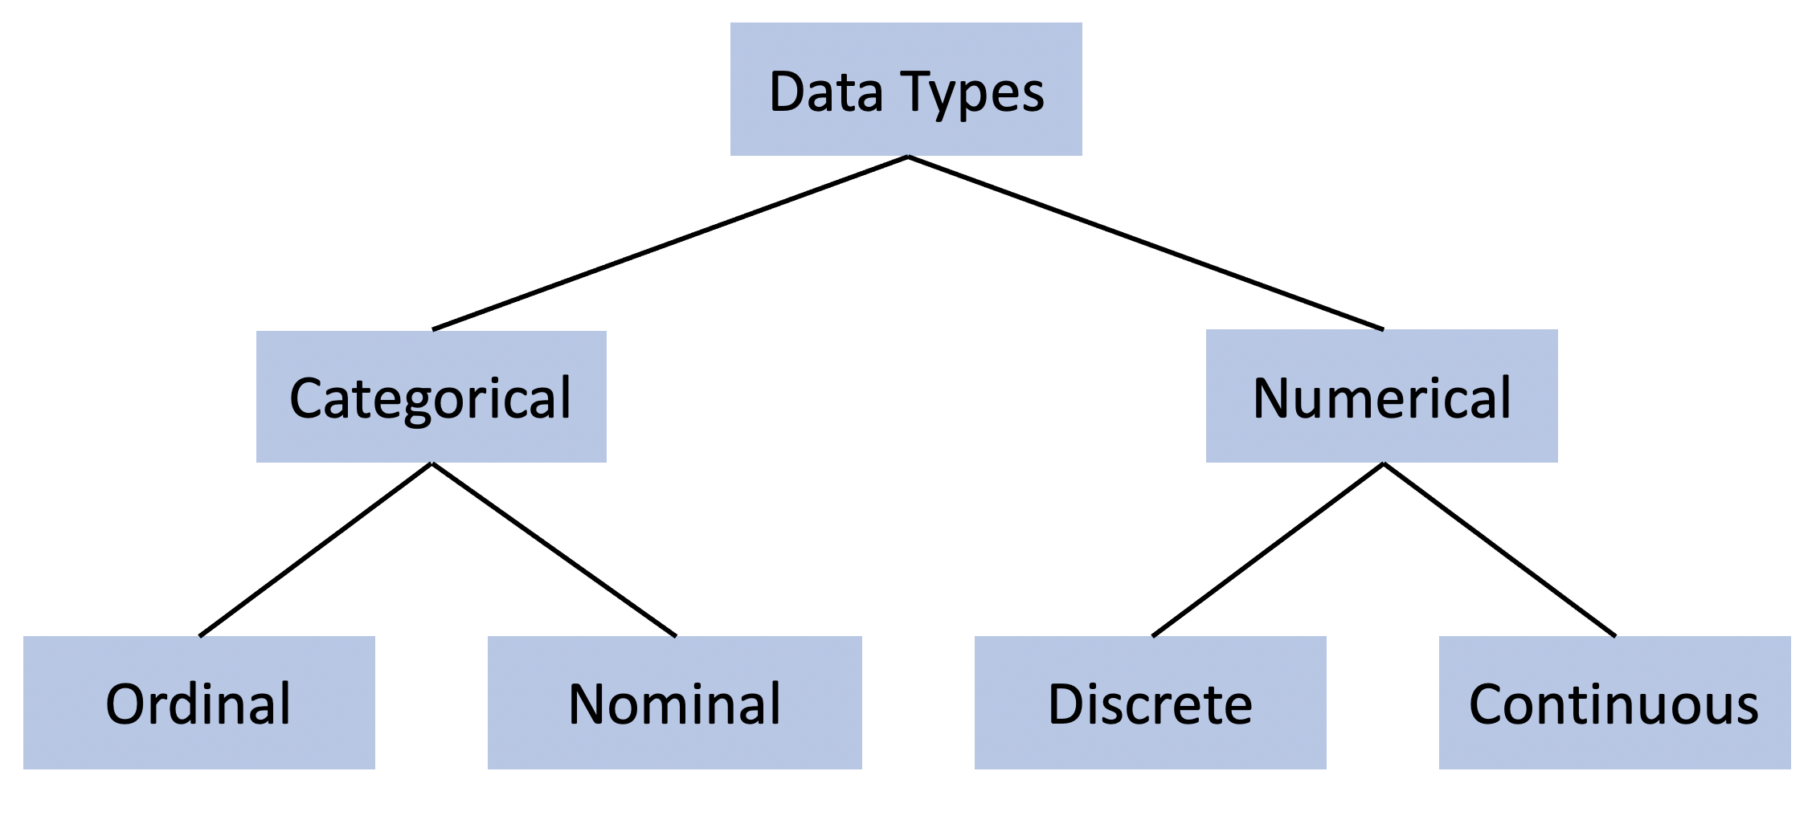
Handling Categorical Features
We know that our data have 2 types.
Categorical variables are usually represented as ‘strings’ or ‘categories’ and are finite in number. Here are a few examples:
The city where a person lives: Delhi, Mumbai, Ahmedabad, Bangalore, etc.
The department a person works in: Finance, Human resources, IT, Production.
The highest degree a person has: High school, Diploma, Bachelors, Masters, PhD.
The grades of a student: A+, A, B+, B, B- etc.

Slide 8
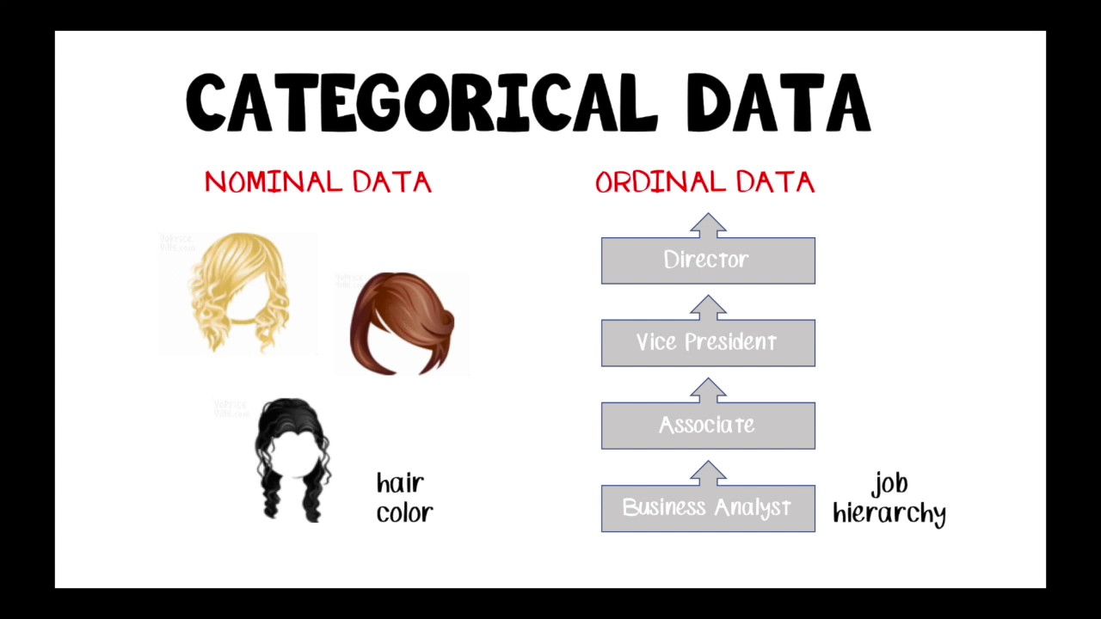
NOW FOCUS IN CATEGORICAL DATA
Is this problem?
Because machine are not able to understand categorical data.
we have to do some magic in that.

Slide 9
I got an Idea
Jio is best
We know one thing, that our computer teacher teached us that machine know only no.s (0 & 1). So if some how we changed our strings into no.s . Then we can solve our problem

Slide 10
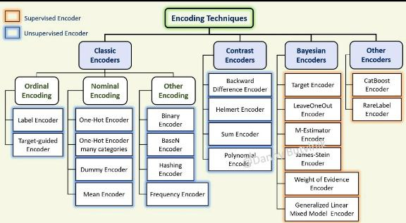
How we can change categorical data into numbers?

Slide 11
We will learn 3 most important technique
What about other types?
Ordinal
Encoding
Label Encoding
One Hot Encoding

Slide 12
Condition:
But maximum people using for x also
Label Encoder
If our Y(dependent variable or output column) in dataset have categorical ( in case of classification problem) then we use Label Encoder
Ordinal Encoder
If our X (independent variable or input columns) have ordinal data type in that case we will use ordinal encoder
One Hot Encoder
If we have nominal data type we will use one hot encoder

Slide 13
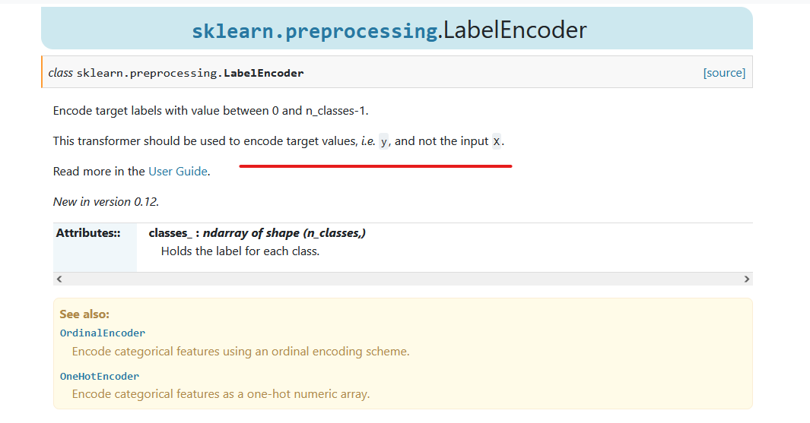
This is mentioned clearly in official side of SK learn
https://scikit-learn.org/stable/modules/generated/sklearn.preprocessing.LabelEncoder.html

Slide 14
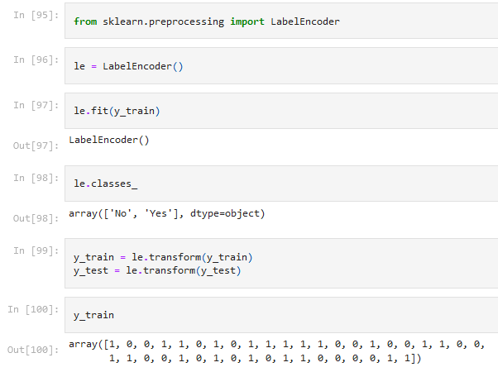
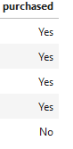
Label Encoder

Slide 15
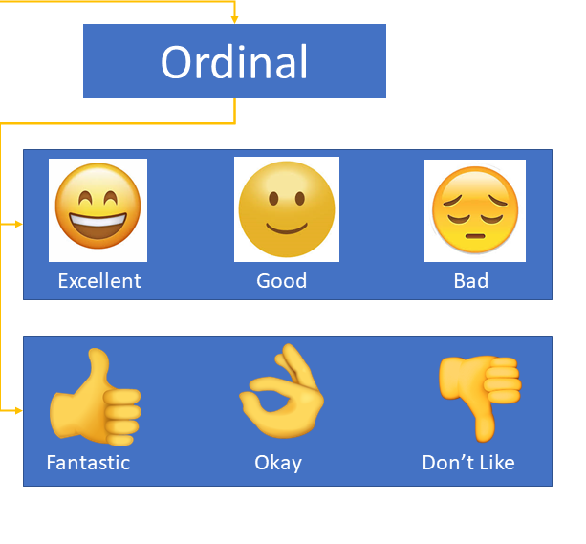
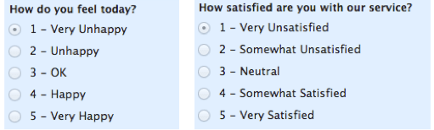
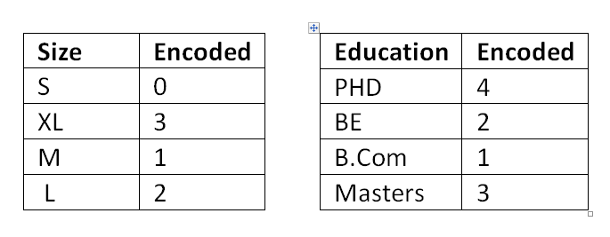
Ordinal Encoder
Where Order of data matters

Slide 16
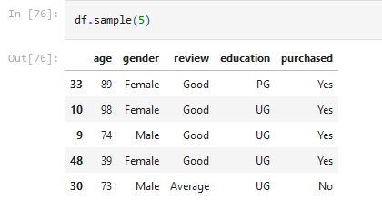
Order Encoder
Label Encoder
We have to decide that which encoder we will use for which categorical variable
One Hot

Slide 17
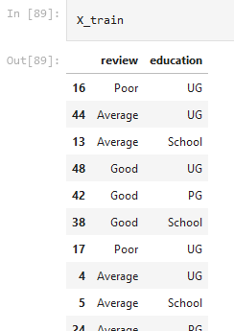
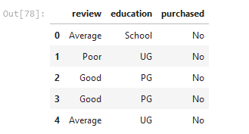
👨 we will take review and education for Order Encoder

Slide 18
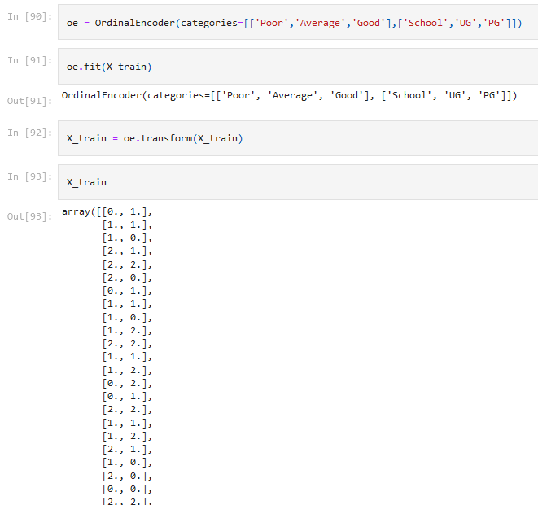
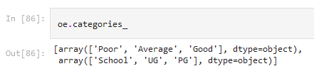
Now we have to keep in mind that we have to give this as priority basis .Lower to higher
📌

Slide 19
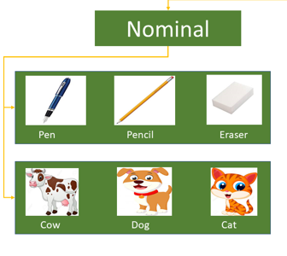
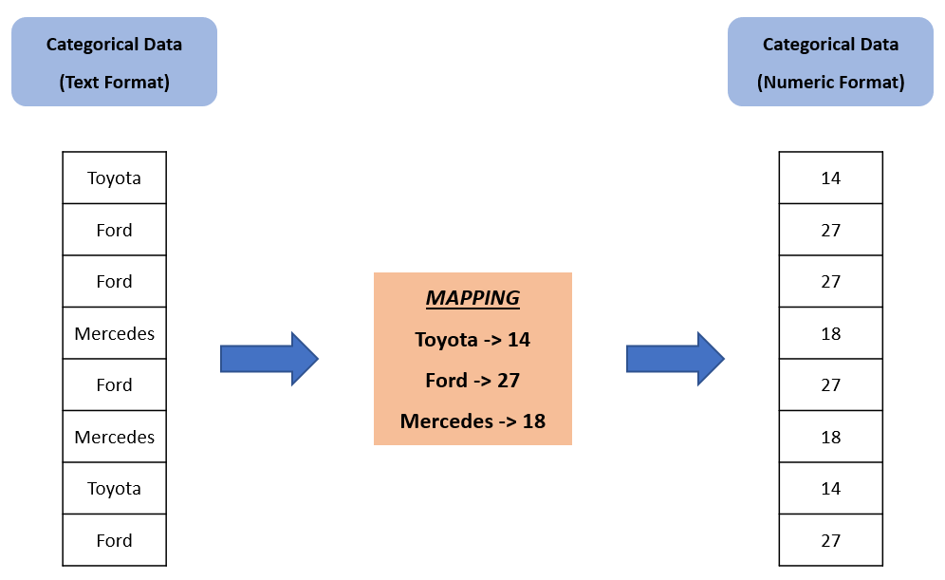
One Hot Encoder
Where Order of data doesn’t matters

Slide 20
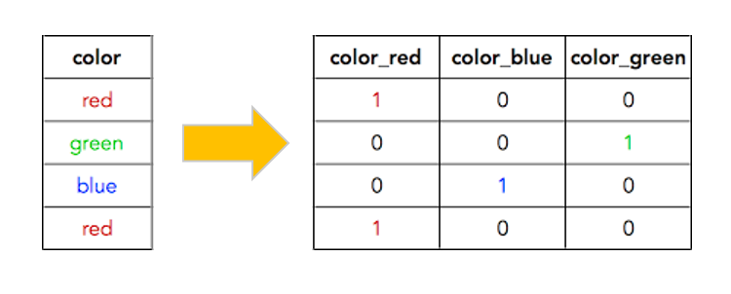
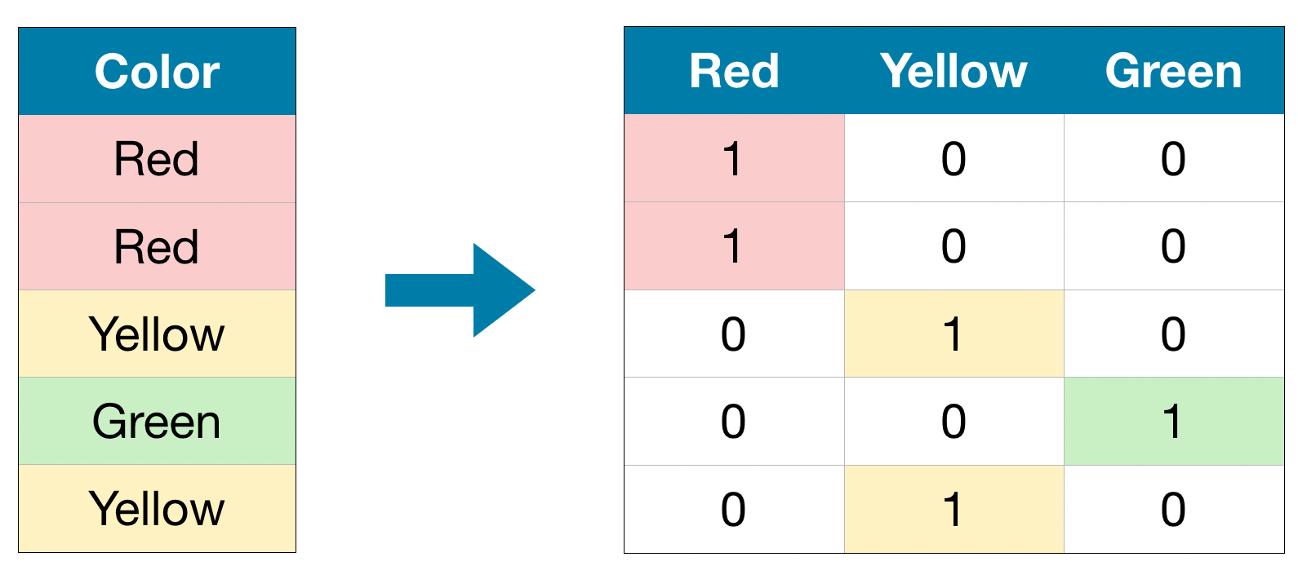
One Hot Encoder
If we have 50 categories in a column then?
In this method, we map each category to a vector that contains 1 and 0 denoting the presence of the feature or not. The number of vectors depends on the categories which we want to keep. For high cardinality features, this method produces a lot of columns that slows down the learning significantly. There is a buzz between one hot encoding and dummy encoding and when to use one. They are much alike except one hot encoding produces the number of columns equal to the number of categories and dummy producing is one less. This should ultimately be handled by the modeler accordingly in the validation process.

Slide 21
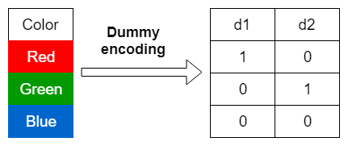
Dummy variable trap
First tell me what is Dummy variable
One hot encoding is used in regression models following label encoding. This enables us to create new attributes according to the number of classes present in the categorical attribute i.e if there are n number of categories in categorical attribute, n new attributes will be created. These attributes created are called Dummy Variables. Hence, dummy variables are “proxy” variables for categorical data in regression models. These dummy variables will be created with one-hot encoding and each attribute will have a value of either 0 or 1, representing the presence or absence of that attribute.

Slide 22
Dummy variable trap
📌
Dummy variable create
Multicollinearity problem
Dummy Variable Trap: The Dummy variable trap is a scenario where there are attributes that are highly correlated (Multicollinearity) and one variable predicts the value of others. When we use one-hot encoding for handling the categorical data, then one dummy variable (attribute) can be predicted with the help of other dummy variables. Hence, one dummy variable is highly correlated with other dummy variables. Using all dummy variables for regression models leads to a dummy variable trap. So, the regression models should be designed to exclude one dummy variable.
For Example – Let’s consider the case of gender having two values male (0 or 1) and female (1 or 0). Including both the dummy variable can cause redundancy because if a person is not male in such case that person is a female, hence, we don’t need to use both the variables in regression models. This will protect us from the dummy variable trap.
.

Slide 23
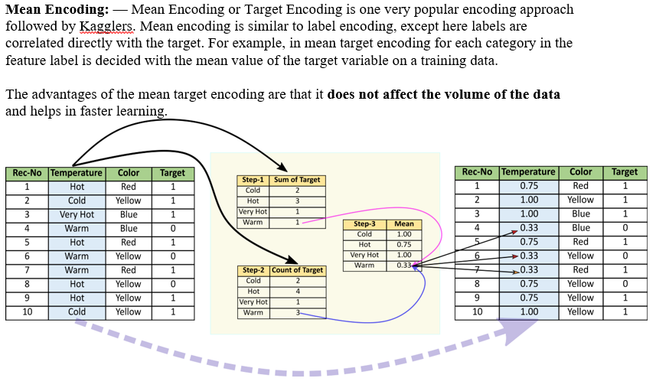
What if no. s of categories in column
📌
You can use other encoding techniques also
Take most frequent categories and combined other left categories into one new categories.
Mean Encoding

Slide 24
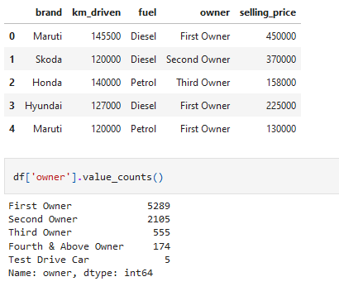

Slide 25
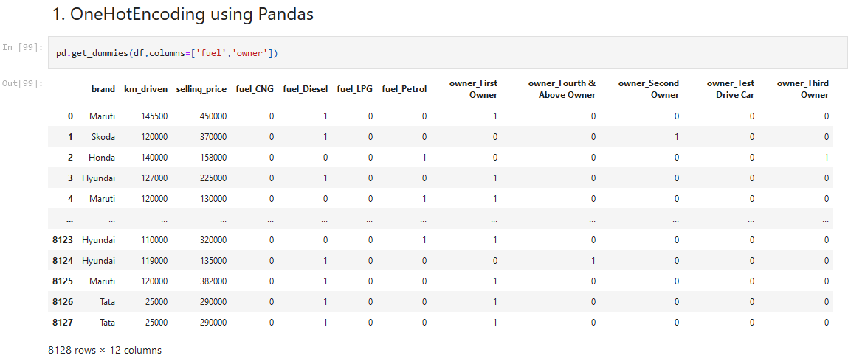
But you told us to drop one dummy

Slide 26
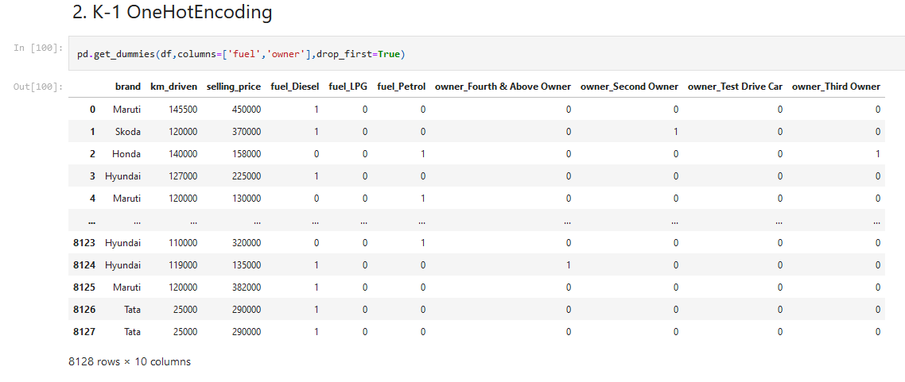

Slide 27
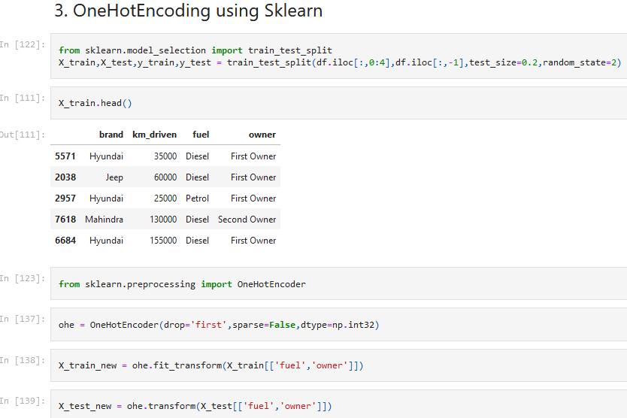

Slide 28
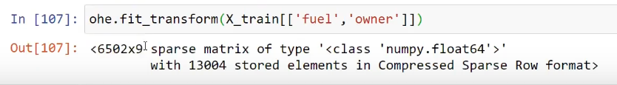
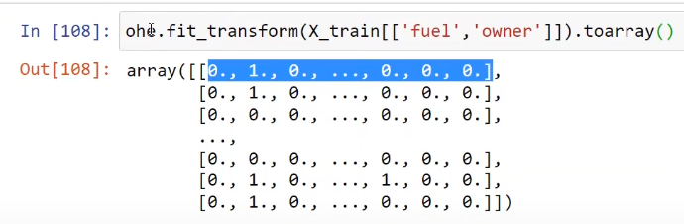
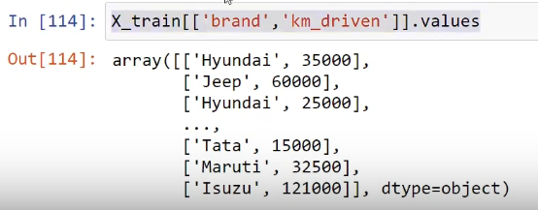
📌
One Hot encoder by default create sparse matrix
If you provide parameter sparse=False at the time of making ohe.
Then there is no need to convert this into toarray()
👨
Now we have to remove original column and at the place of that we will append this array.
First we will separate these two

Slide 29
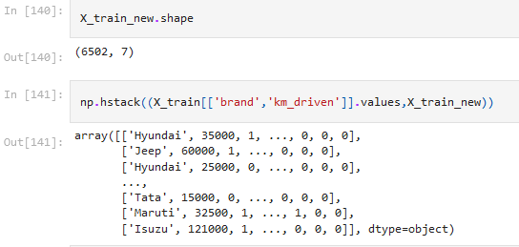
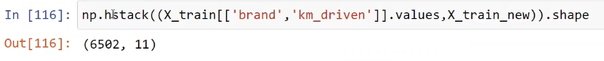
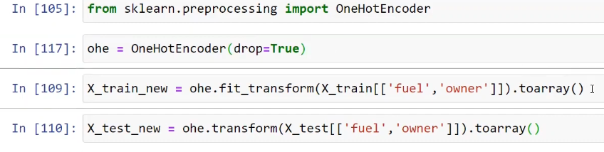
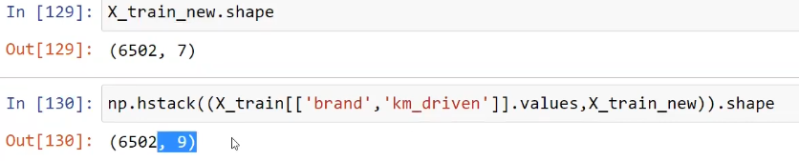
If you provide parameter dtype=“int32” at the time of making ohe.
Then we can convert float into integer
👨
But if we want to remove one dummy to adjusts Multicollinearity issue. You can write

Slide 30
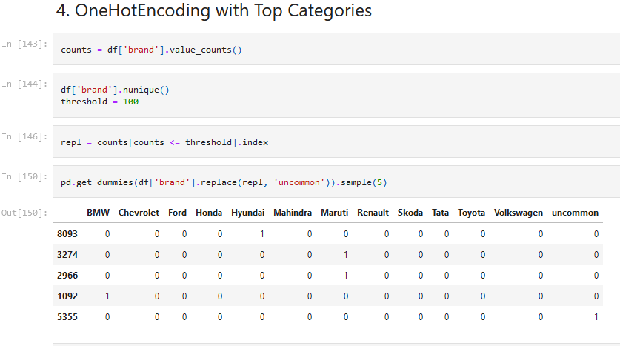
👨 Column transform of sk learn is easiest way of doing all these

Slide 31


2. Missing value imputation
Let’s start with the second set of slides

Slide 33
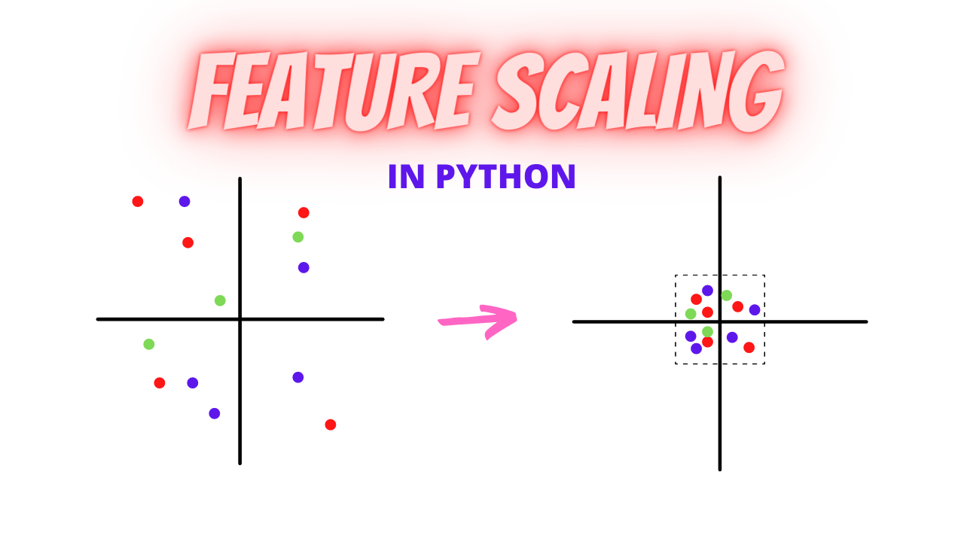
4. Feature Scaling
Let’s start with the fourth set of slides

Slide 34
What is Feature Scaling?
When in ML dataset had multiple features spanning varying degrees of magnitude, range, and units. Then this is a significant obstacle as a few machine learning algorithms are highly sensitive to these features.
For example, one feature is entirely in kilograms while the other is in grams, another one is liters, and so on. How can we use these features when they vary so vastly in terms of what they’re presenting?
This is where I turned to the concept of feature scaling. It’s a crucial part of the data preprocessing stage but lot of beginners overlook it (to the detriment of their machine learning model).

Slide 35
Why Should we Use Feature Scaling?
Some machine learning algorithms are sensitive to feature scaling while others are virtually invariant to it. Like:
Sensitive
Linear Regression
Not sensitive
Tree Based Algorithm
Logistic Regression
K-means
SVM
Boosting Algorithm
Gradient Descent Based Algorithms
Distance-Based Algorithms
Neural Networks

Slide 36
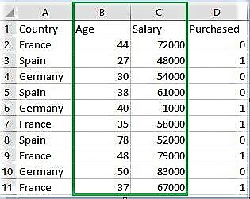
Example:
If an algorithm is not using the feature scaling method then it can consider the value 3000 meters to be greater than 5 km but that’s actually not true and in this case, the algorithm will give wrong predictions. So, we use Feature Scaling to bring all values to the same magnitudes and thus, tackle this issue.

Slide 37
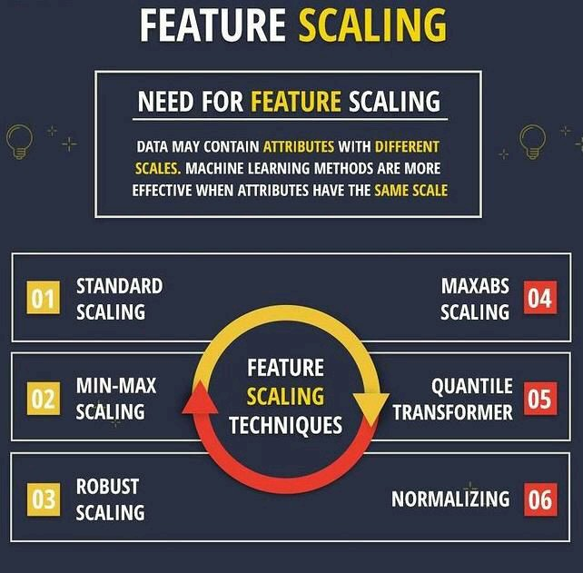
Techniques to perform Feature Scaling

Slide 38
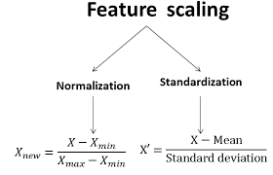
But we will learn two most important technique

Slide 39
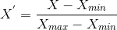
What is Normalization / min-max scaling?
Normalization is a scaling technique in which values are shifted and rescaled so that they end up ranging between 0 and 1. It is also known as Min-Max scaling.
Here’s the formula for normalization:
Here, Xmax and Xmin are the maximum and the minimum values of the feature respectively.
When the value of X is the minimum value in the column, the numerator will be 0, and hence X’ is 0
On the other hand, when the value of X is the maximum value in the column, the numerator is equal to the denominator and thus the value of X’ is 1
If the value of X is between the minimum and the maximum value, then the value of X’ is between 0 and 1

Slide 40
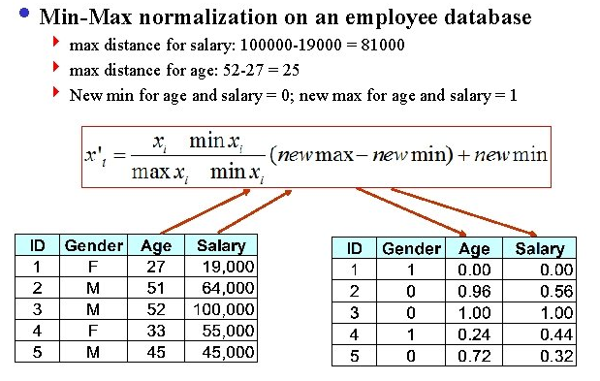

Slide 41
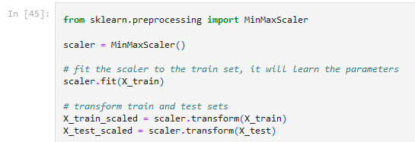
Drawback: It pushes outlier also into range of 0 to 1. i.e it effect on outlier while standardization doesn't effect outliers.

Slide 42
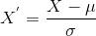
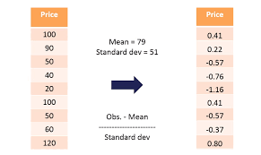
What is Standardization?
Standardization is another scaling technique where the values are centered on the mean with a unit standard deviation. This means that the mean of the attribute becomes zero and the resultant distribution has a unit standard deviation.
Here’s the formula for standardization:
Note that in this case, the values are not restricted to a particular range.

Slide 43
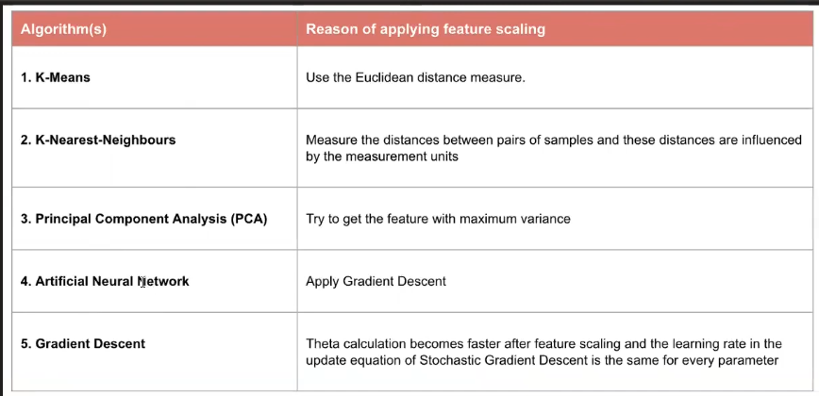
Where we have to use Standarization?

Slide 44
Scaling in Python Coding
from sklearn import preprocessing
""" MIN MAX SCALER """
min_max_scaler = preprocessing.MinMaxScaler(feature_range =(0, 1))
# Scaled feature
x_after_min_max_scaler = min_max_scaler.fit_transform(x)
print ("\nAfter min max Scaling : \n", x_after_min_max_scaler)
""" Standardisation """
Standardisation = preprocessing.StandardScaler()
# Scaled feature
x_after_Standardisation = Standardisation.fit_transform(x)
print ("\nAfter Standardisation : \n", x_after_Standardisation)

Slide 45
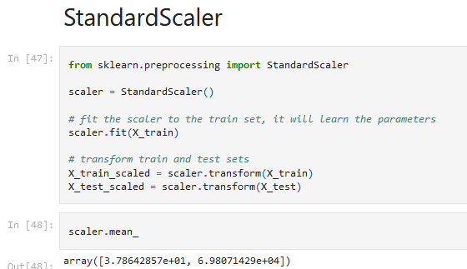

Slide 46
The Big Question – Normalize or Standardize?
Normalization vs. standardization is an eternal question among machine learning newcomers. Let me elaborate on the answer in this section.
Normalization is good to use when you know that the distribution of your data does not follow a Gaussian distribution. This can be useful in algorithms that do not assume any distribution of the data like K-Nearest Neighbors and Neural Networks.
Standardization, on the other hand, can be helpful in cases where the data follows a Gaussian distribution. However, this does not have to be necessarily true. Also, unlike normalization, standardization does not have a bounding range. So, even if you have outliers in your data, they will not be affected by standardization.
However, at the end of the day, the choice of using normalization or standardization will depend on your problem and the machine learning algorithm you are using. There is no hard and fast rule to tell you when to normalize or standardize your data. You can always start by fitting your model to raw, normalized and standardized data and compare the performance for best results.

Slide 47
5. Mathematical Transformation
Lets start 5th section of this presentation

Slide 48
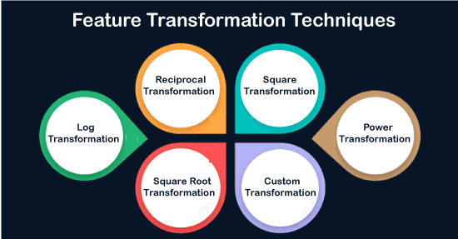
These transformation is used to convert data distribution into normal distribution
In case of Left skewed
In case of Right skewed but all point should be positive

Slide 49
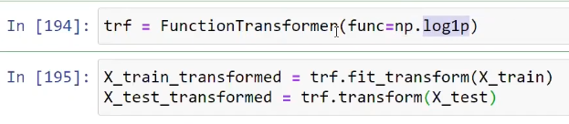
Python code

Slide 50

THANKS!
Any questions?
You can find me at:
himanshu.shukla.him@gmail.com

